Slide 1
  WI-FI INDOOR LOCALIZATION
Team 8 | 23CSE301 Machine Learning Capstone
23CSE301 • TEAM 8

Slide 2
  REVIEW 2 SCOPE
Project: Wi-Fi fingerprint-based indoor localization using machine learning.
Focus: compare classifiers, evaluate cluster quality, interpret plots, and assess generalization.
Team:
  K. Ganesh Giridhar (519),
  A. Suhas Reddy (503),
  G. R. Balaji (510).
23CSE301 • TEAM 8

Slide 3
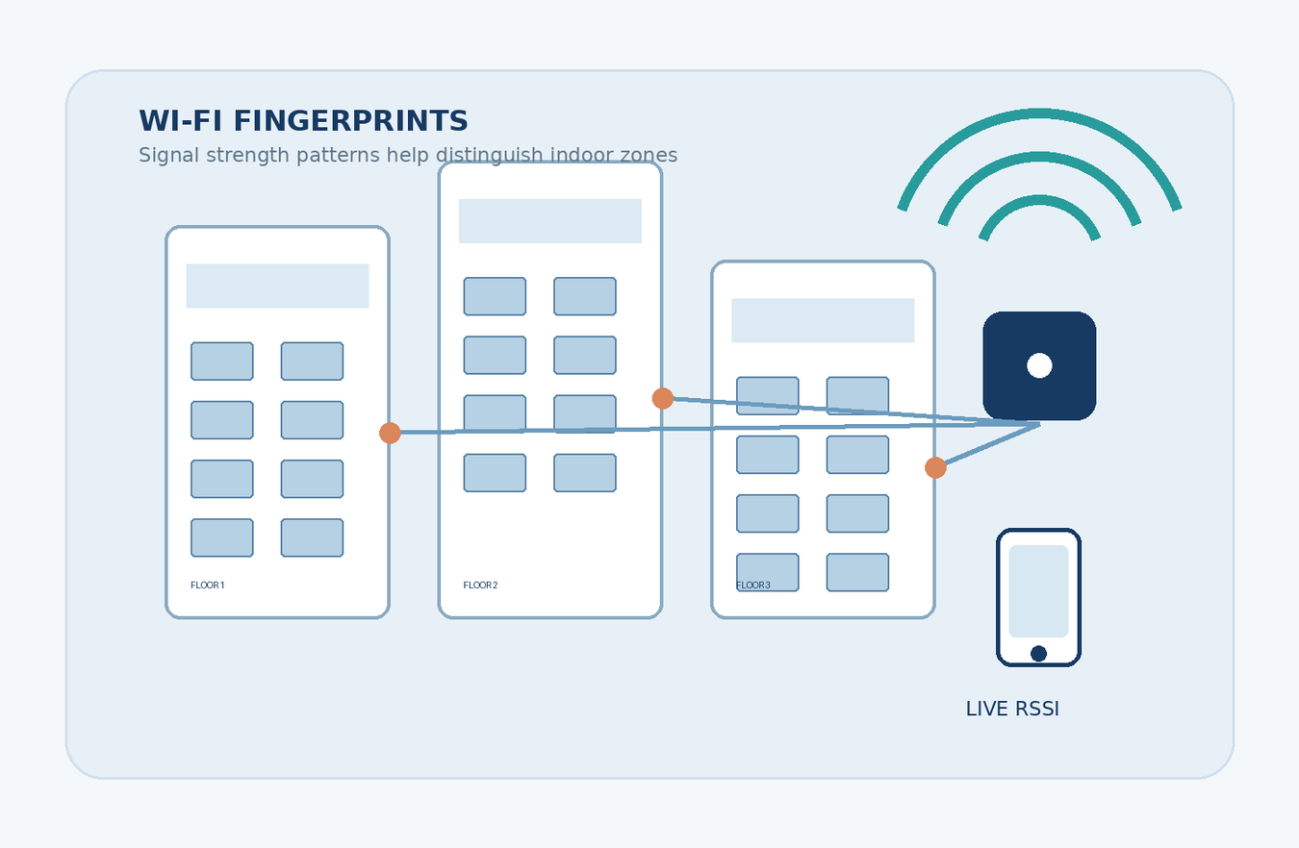
  UJINDOORLOC DATASET
  19,937 training records • 520 original WAP RSSI features
  +100 (not detected) → −105 dBm
  Removed 55 zero-variance WAPs; retained 465 active WAPs
  Added 5 RSSI aggregate features → 470 final features
23CSE301 • TEAM 8

Slide 4
  THREE ML TRACKS
1
Regression estimates coordinates (X, Y) from Wi-Fi RSSI fingerprints.
2
Classification predicts floor (0–4).
Clustering learns RSSI structure without building/floor labels during fitting.
3
23CSE301 • TEAM 8

Slide 5
  CLASSIFICATION — PART B
1
  Random Forest: averages many decision trees; tuned setup used 200 trees and max_depth=25.
  Gradient Boosting: sequential trees correct earlier errors.
  Bagging: trains learners on bootstrap samples.
  AdaBoost: reweights hard-to-classify records.
2
MLP: dense neural network that learns nonlinear RSSI patterns.
Internal test:
weighted F1 0.9932 (AUC 0.9996).
Tuned Random Forest weighted F1 0.9922.
23CSE301 • TEAM 8

Slide 6
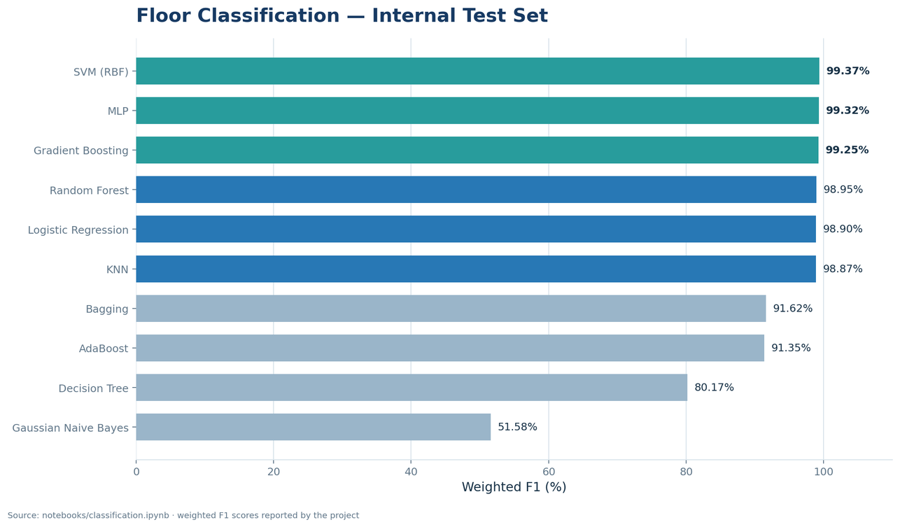
  CLASSIFIER PERFORMANCE
Top internal test models:
SVM (RBF) —
  weighted F1
  0.9937, AUC 0.9989
MLP—
  weighted F1 0.9932,
  AUC 0.9996
Gradient Boosting —
  weighted F1 0.9925,
  AUC 0.9997
Tuned Random Forest —
  weighted F1 0.9922
23CSE301 • TEAM 8

Slide 7
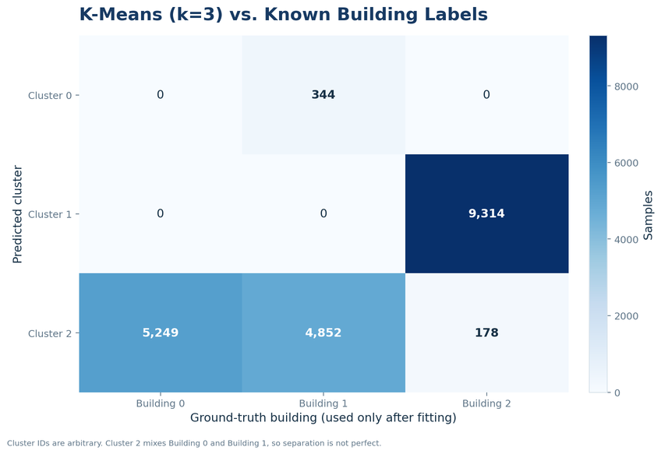
  CLUSTER INTERPRETATION
Building labels were used only after fitting.
Cluster 0: 344 records, all Building 1.
Cluster 1: 9,314 records, all Building 2.
Cluster 2 is mixed:
Building 0 = 5,249;
Building 1 = 4,852;
Building 2 = 178.
This is not a perfect building mapping; one cluster mixes buildings substantially.
23CSE301 • TEAM 8

Slide 8
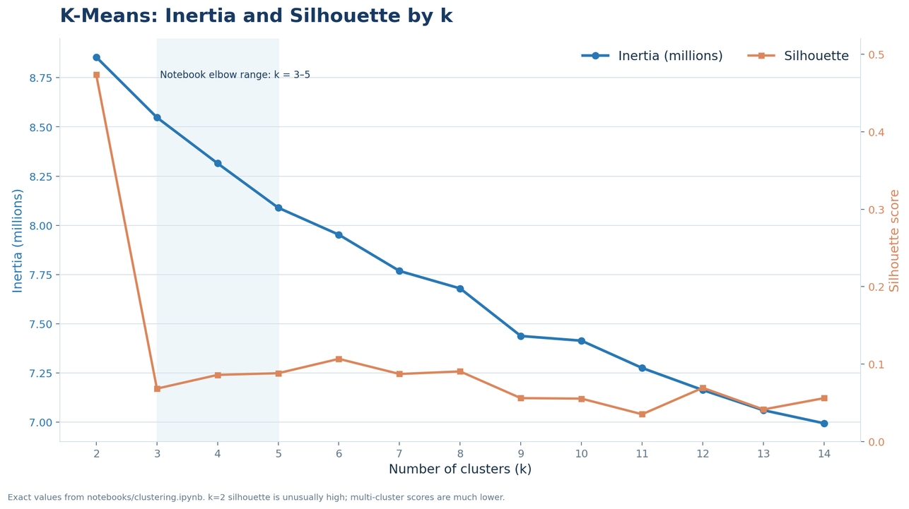
  K-MEANS: CHOOSING K
Elbow region: around k = 3–5.
For k ≥ 3, silhouette is generally low, indicating overlapping clusters.
Among tested multi-cluster runs, K-Means k=5 had the highest silhouette (0.0883) and lowest DB (2.9513).
The first two PCA components explain only 10.50% of variance.
23CSE301 • TEAM 8

Slide 9
  CLUSTER METRICS
K-MEANS
k=3: Silhouette 0.0684 | DB 3.2018 | CH 958.62
k=5: Silhouette 0.0883 | DB 2.9513 | CH 789.03
k=5 improves silhouette and DB; CH is higher at k=3.
1
AGGLOMERATIVE WARD
k=3: Silhouette 0.0670 | DB 3.1815 | CH 936.98
k=5: Silhouette 0.0784 | DB 2.9978 | CH 769.54
Scores indicate weak separation across these runs.
2
23CSE301 • TEAM 8

Slide 10
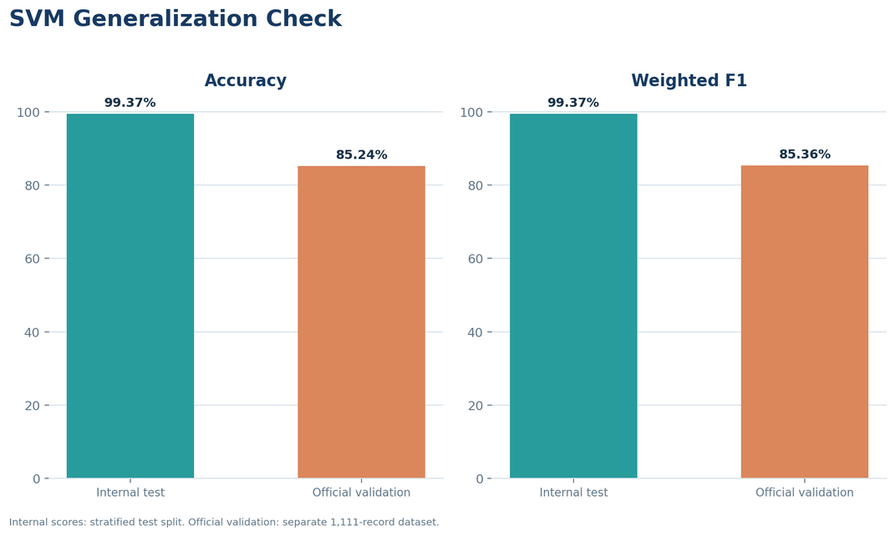
  CONCLUSION & LIMITATIONS
Internal SVM test: accuracy/F1 99.37%; AUC 0.9989.
Official validation (1,111 records): accuracy 85.24%; weighted F1 85.36%.
The gap signals a generalization challenge; device/time shift is plausible, not proven.
Next: campus data + cross-device/time testing.
Dataset: UJIIndoorLoc (UCI); Torres-Sospedra et al., IPIN 2014.
Repo: github.com/Ganesh2006646/Machine-Learning---Case-Study
23CSE301 • TEAM 8

Slide 11
  THANK YOU
23CSE301 • TEAM 8

